Slide 1
WebEOC Beyond the Disaster
2025 Juvare User Conference
January 15, 2025
Aaron Funk, Operations Chief
Seminole County Office of Emergency Management

Slide 2
Why Expanding Use of WebEOC is Beneficial
System Awareness / By-In
Developing use cases beyond disaster activation expands awareness, and support for system use from internal and external partners is increased.
System Proficiency
Many end users may only utilize the system during a major disaster / emergency. Daily use of any system will increase proficiency.
Increased System Maturity
As regular system use increases, assessment, improvement, and ideas for enhancement increase more rapidly.
Enhancement of Local Processes
WebEOC can be a great tool for enhancing many local processes of information collection, documentation, visualization, and sharing.

Slide 3
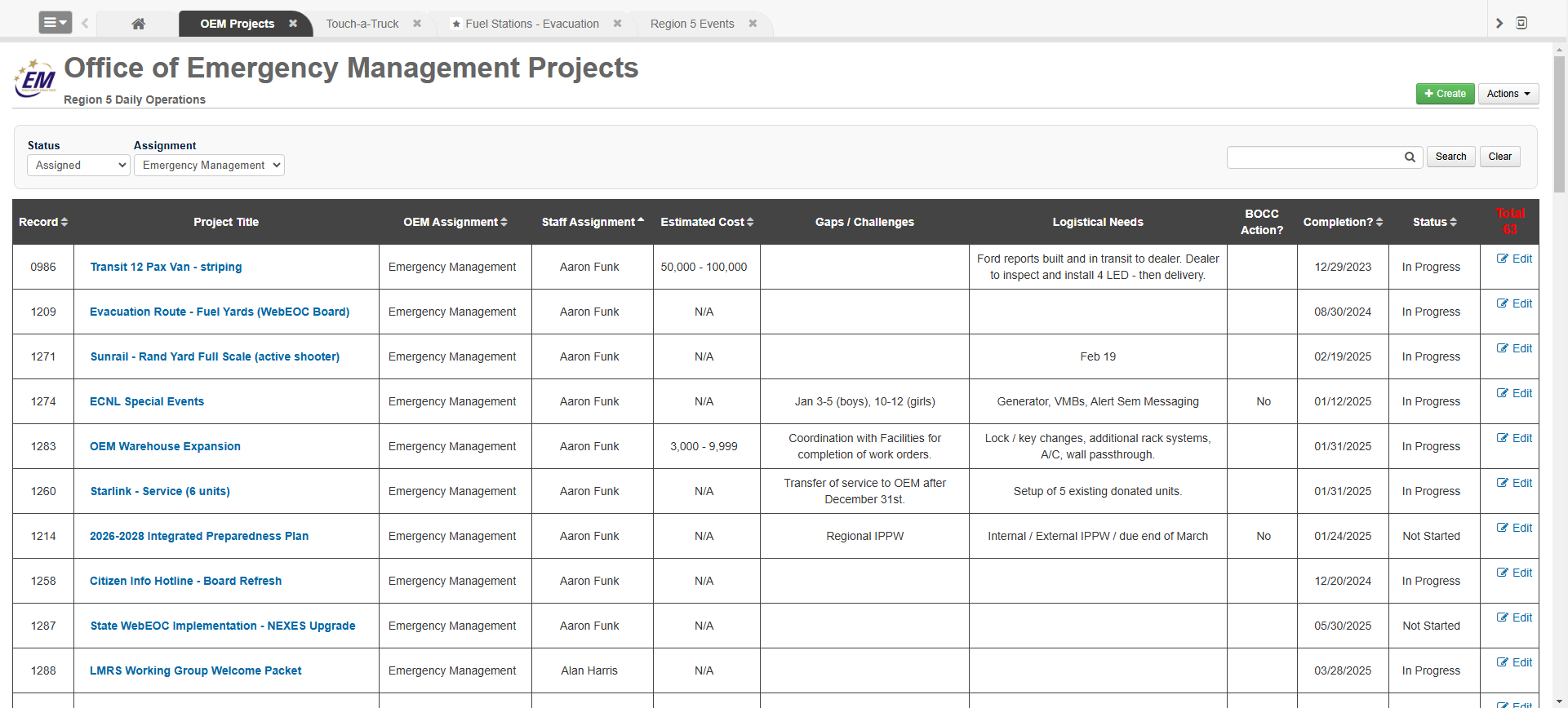
Daily Use Cases – Project Management
Developed originally in 2017 to replace a local Excel process.
Used daily to track Office of Emergency Management Projects, as well as other in other Departments.
Used to present projects and status’ to County Management, Commissioners.
Due for an update to current WebEOC board capabilities and visual look.

Slide 4
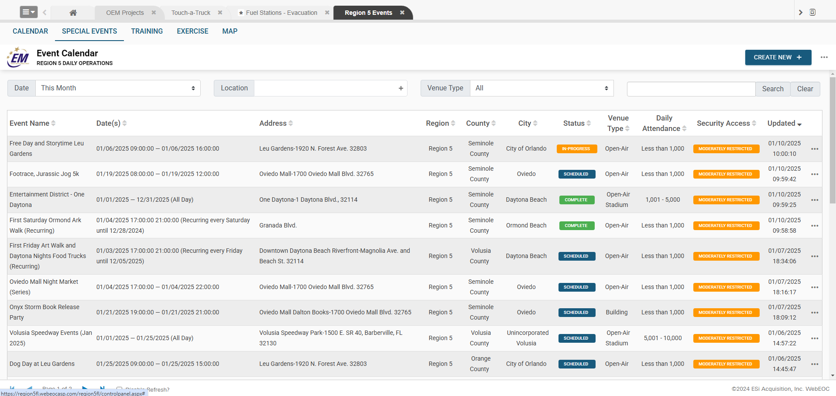
Daily Use Cases – Special Event Tracking
Developed originally to enhance local process for tracking of special events.
Tracks permitted events, and events of significance.
Expanded to Regional use. Used for UASI, and CFIX awareness.
Further expanded to track regional training and exercises.

Slide 5
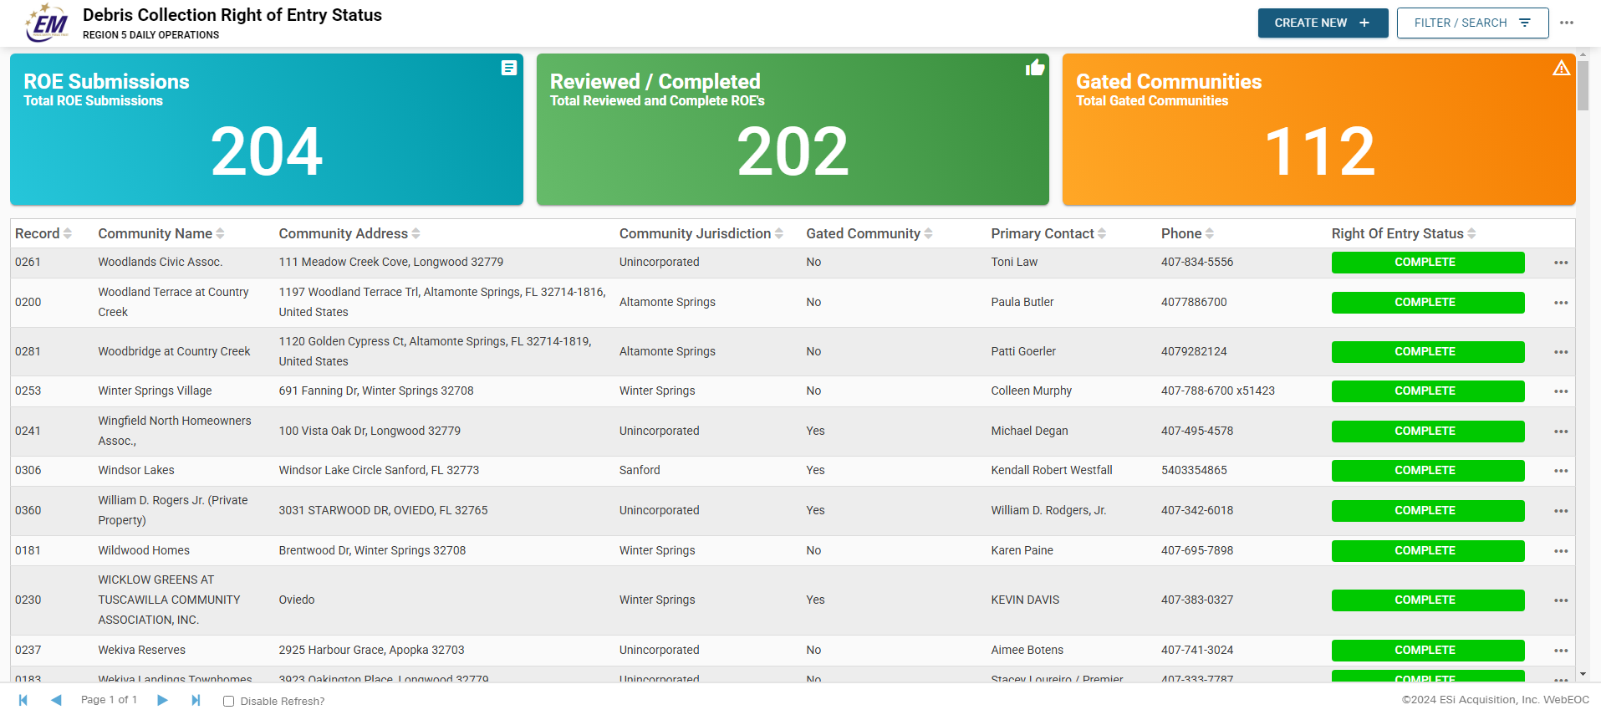
Daily Use Cases – Debris Right of Entry
Developed to intake, review, and approve debris right of entry forms.
ROE’s are critical for post tropical debris collection.
HOAs, gated communities, etc. utilize an external form to submit the ROE documents to WebEOC for review.
All completed forms and community information are located within the board records.
Debris contractors use the board with iPads in the field.

Slide 6
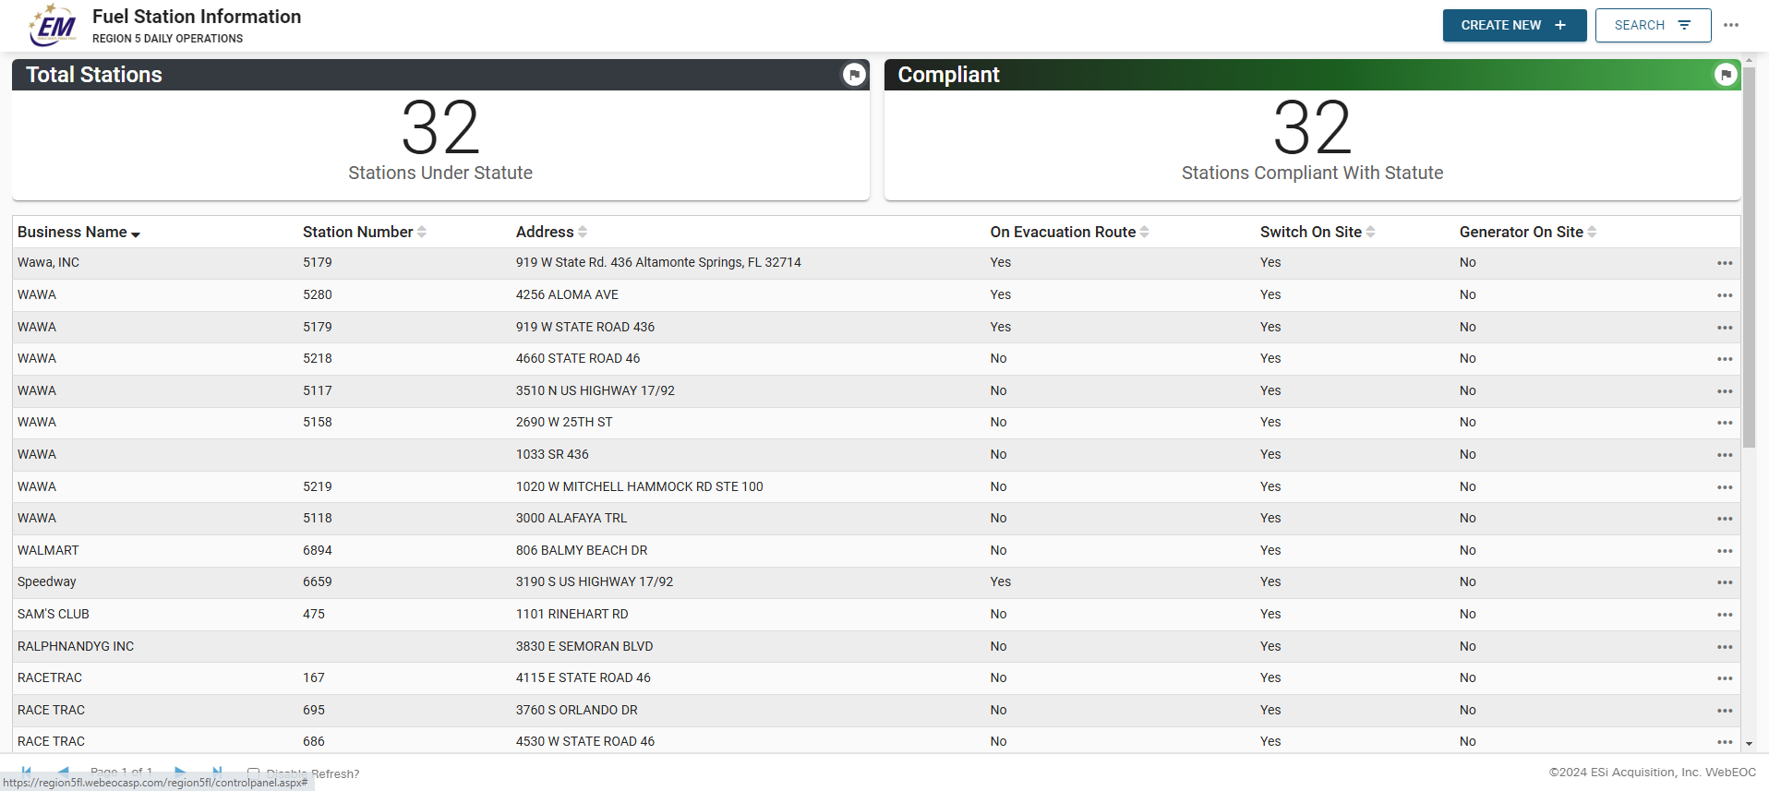
Daily Use Cases – Fuel Station Information
Developed to track fuel station compliance with F.S. 526.143
Updated as new stations are built, and annually prior to hurricane season.
Tracks generator connection and size information.
Points of contact for individual stations, or corporate contacts are listed.

Slide 7
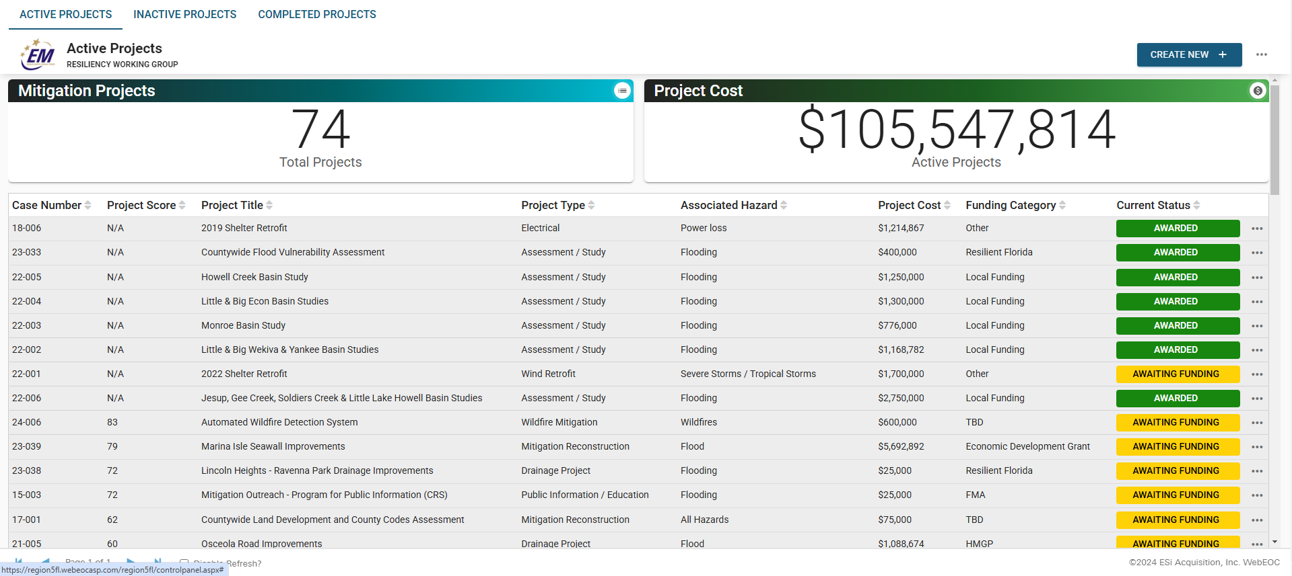
Daily Use Cases – Mitigation Projects
Developed to track fuel station community mitigation projects.
Used by the Local Mitigation and Resiliency working group to track and prioritize projects for funding.
Project submissions through Forms.
Future buildout to include public facing GIS map, connected through ArcGIS Extension.

Slide 8
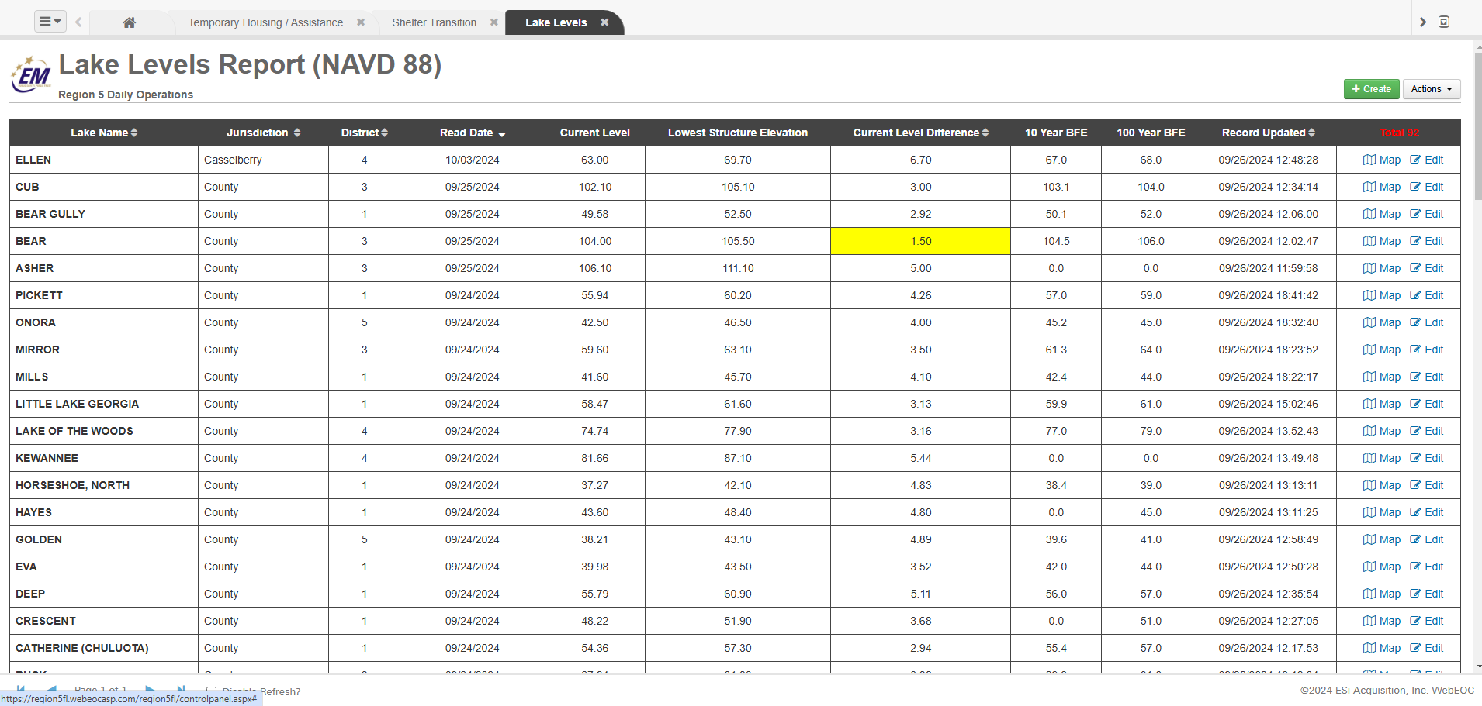
Daily Use Cases – Lake Levels
Developed to enhance lake water level tracking by Watershed Management.
Tracks water level readings, lowest floor elevations, and BFE information.
Assists in decision making during heavy rainfall events.

Slide 9
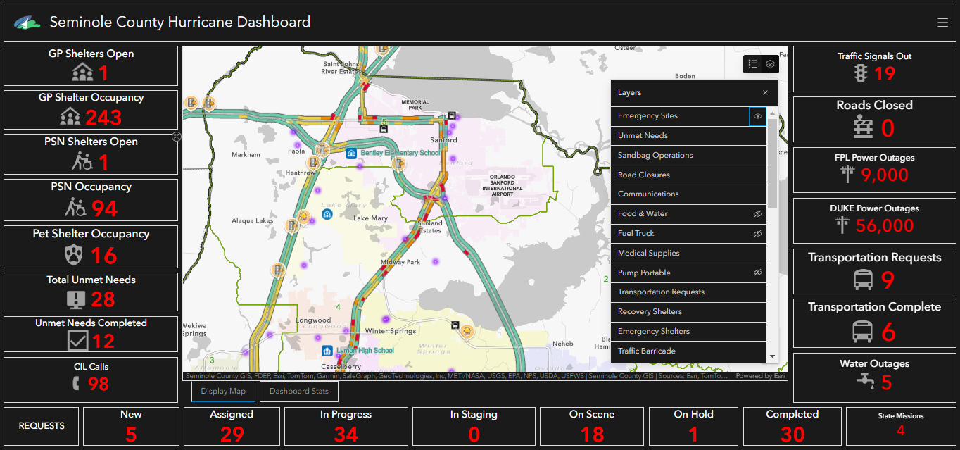
Daily Use Cases – Connection to GIS

Slide 10
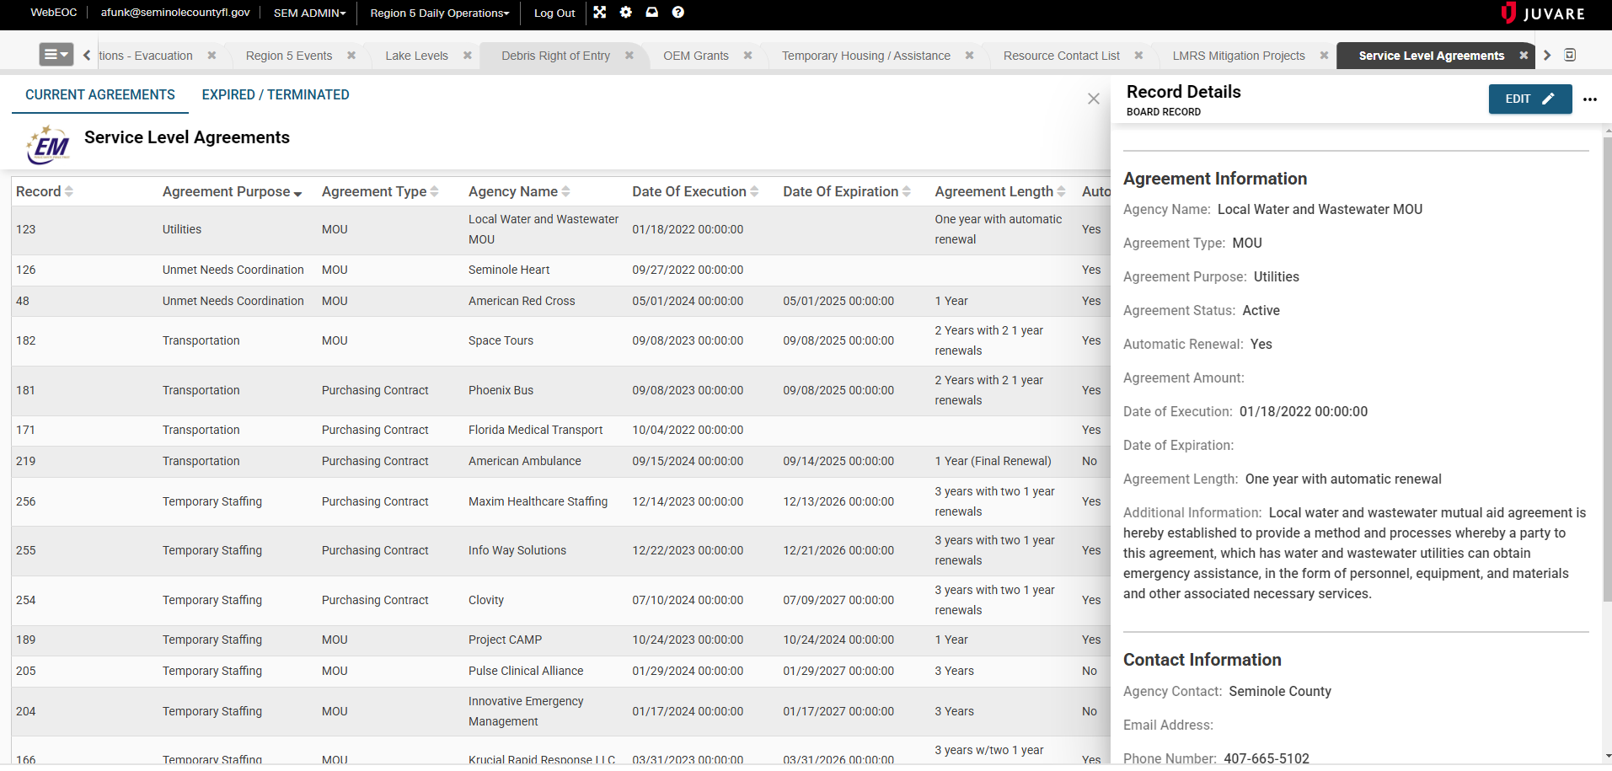
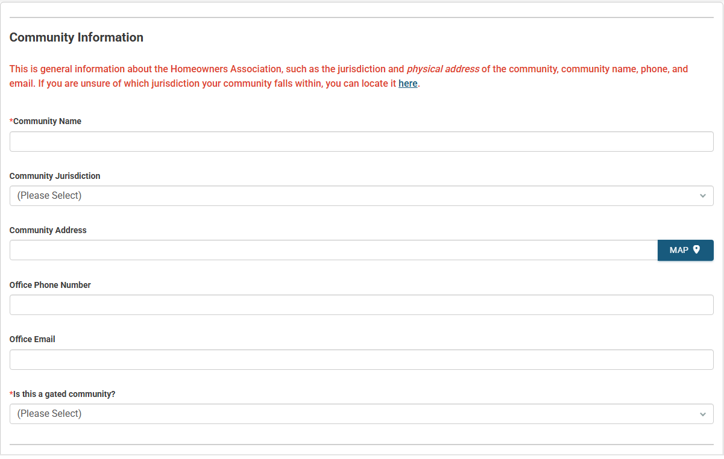
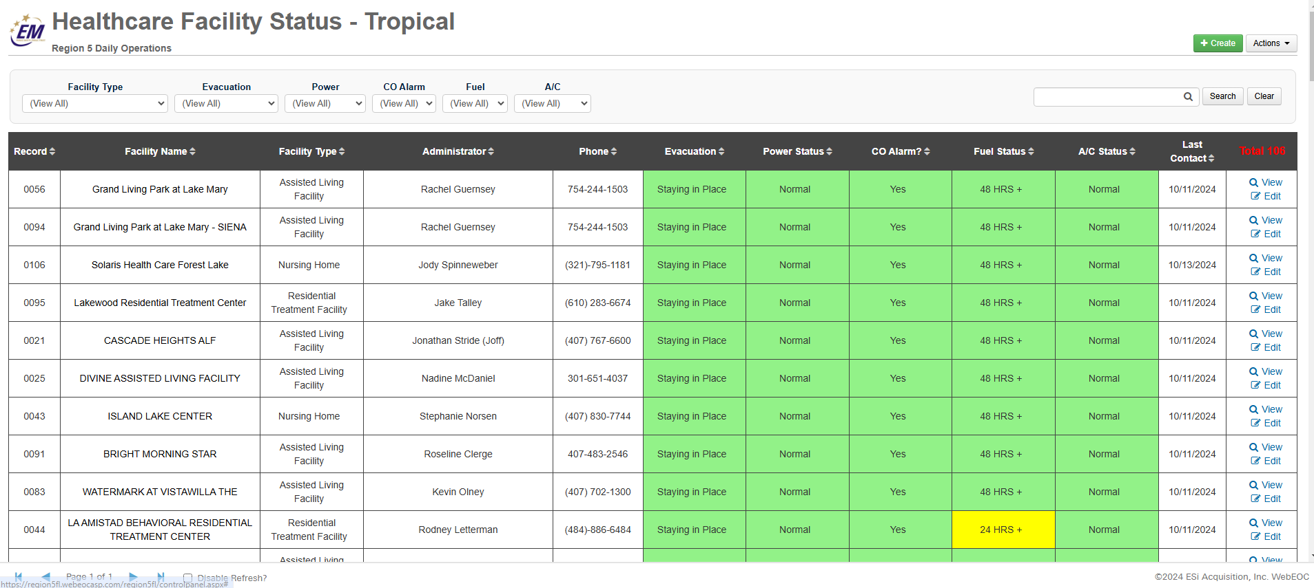
Other Non-Disaster / Emergency Use Cases
Emergency Management Grants
MOUs / Contracts
Event Registrations
Temporary Housing / Case Management
Contact Management
Public Outreach / Engagement
Fire Department Smoke Alarm Installs
Weather Dashboards
EOC Visual Displays

